Slide 1
S
SB37 Effects on Shared Governance at UH: A Pre & Post Assessment
Texas Council of Faculty Senates, Fall Meeting
September 25, 2026 Austin, TX
Dr. Wynne W. Chin*
C. T. Bauer Professor of Decision Science - University of Houston
* The views and material expressed in this presentation are solely my own as an individual and do not necessarily reflect the official positions, policies, or opinions of the University of Houston. Any factual errors are non-intentional.

Slide 2
"Fostering Trust Within Shared Governance Structures
Shared governance helps colleges and universities bring together diverse perspectives, strengthen institutional decision-making, and advance their missions. In this webinar, participants will explore practical strategies for strengthening shared governance, building confidence across campus constituencies, and balancing innovation with accountability.
When shared governance functions effectively, it draws on the collective expertise of the campus community and creates confidence in institutional decision-making. When relationships break down, however, decision-making can become fragmented, innovation can stall, and confidence in institutional processes can erode.
Successful shared governance requires more than clearly defined roles. It depends on campus constituencies recognizing the value of balancing the power to question with the power to innovate, adopting equitable decision-making processes, and working through questions about who should participate in institutional decisions and how. This webinar will examine strategies for strengthening collaboration among students, staff, faculty, administrators, and governing boards while supporting productive, mission-focused governance.
* Fostering Trust Within Shared Governance Structures, American Association of Colleges and Universities, September 30, 2026.

Slide 3
Tradeoff between Quality versus Efficiency
The impact of poor involvement/decision making activity adjudicates the tradeoff
Consider the type and impact of decision: routine structured versus wicked problems
Operational, Tactical, Strategic Problems
Quality (correctness, outcome)
Strategic/Critical task
Routine, Minor Impact task
Speed

Slide 4
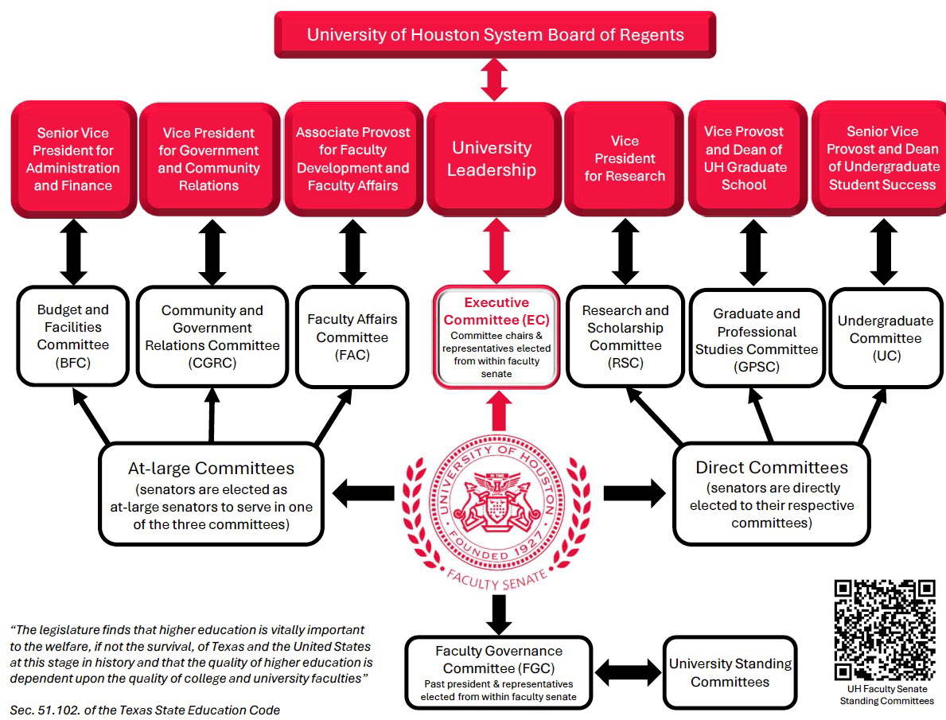
Before SB 37

Slide 5
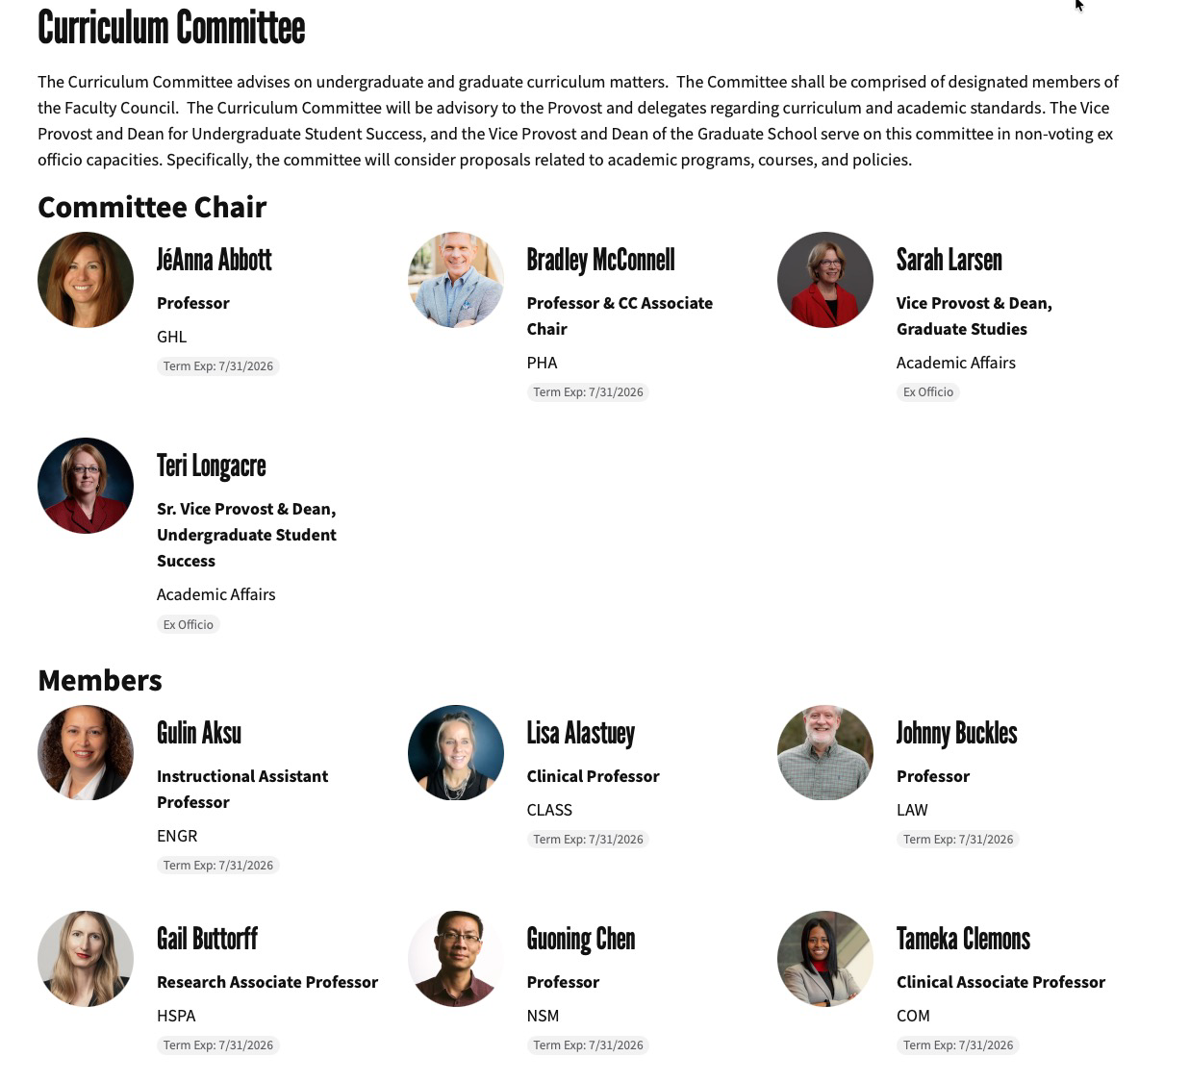
After SB 37 – initial change

Slide 6
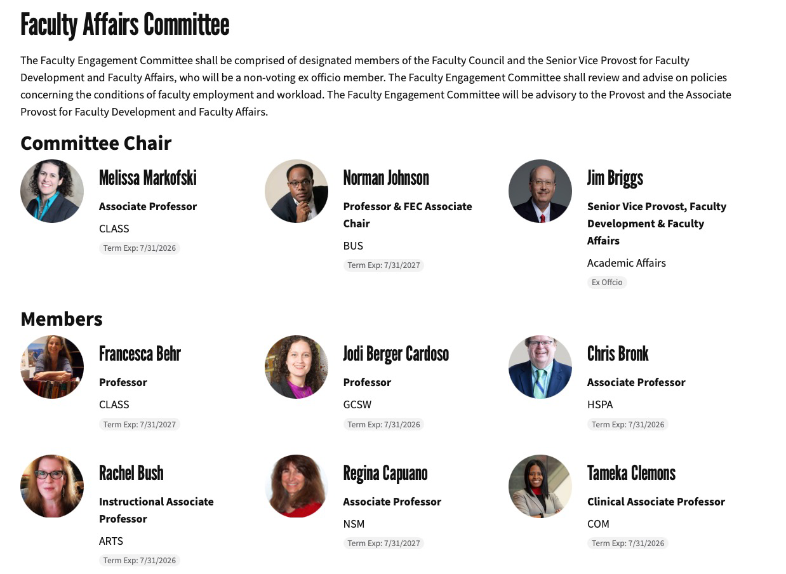

Slide 7
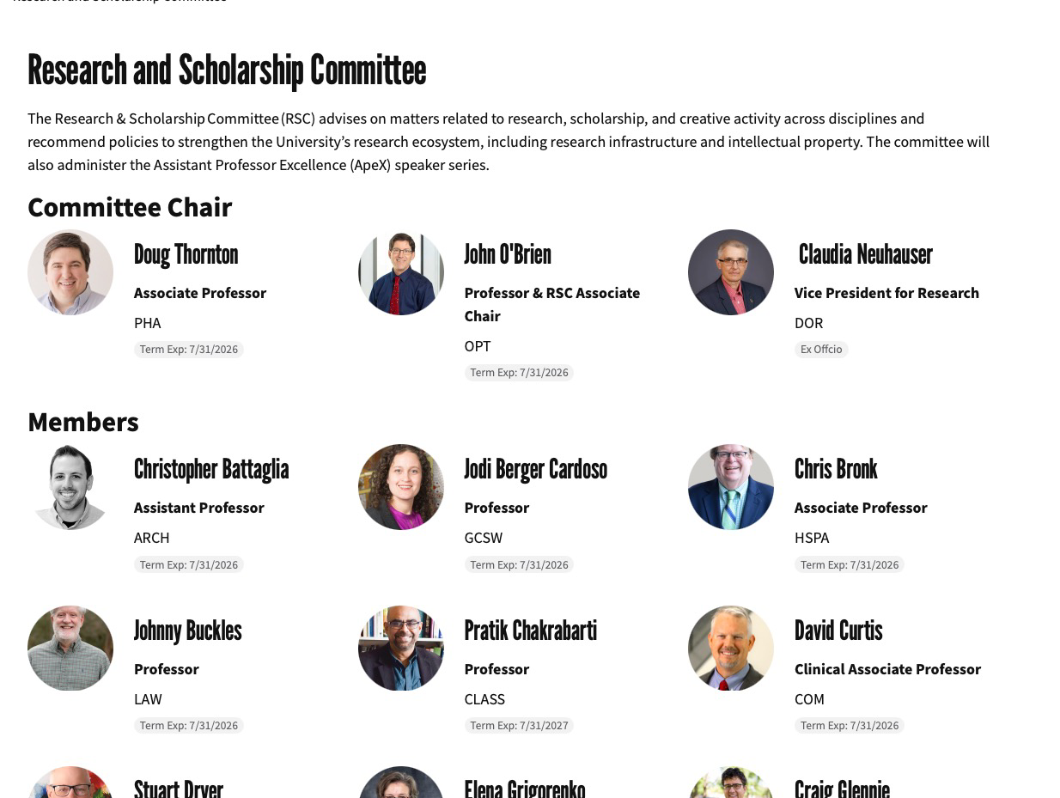

Slide 8
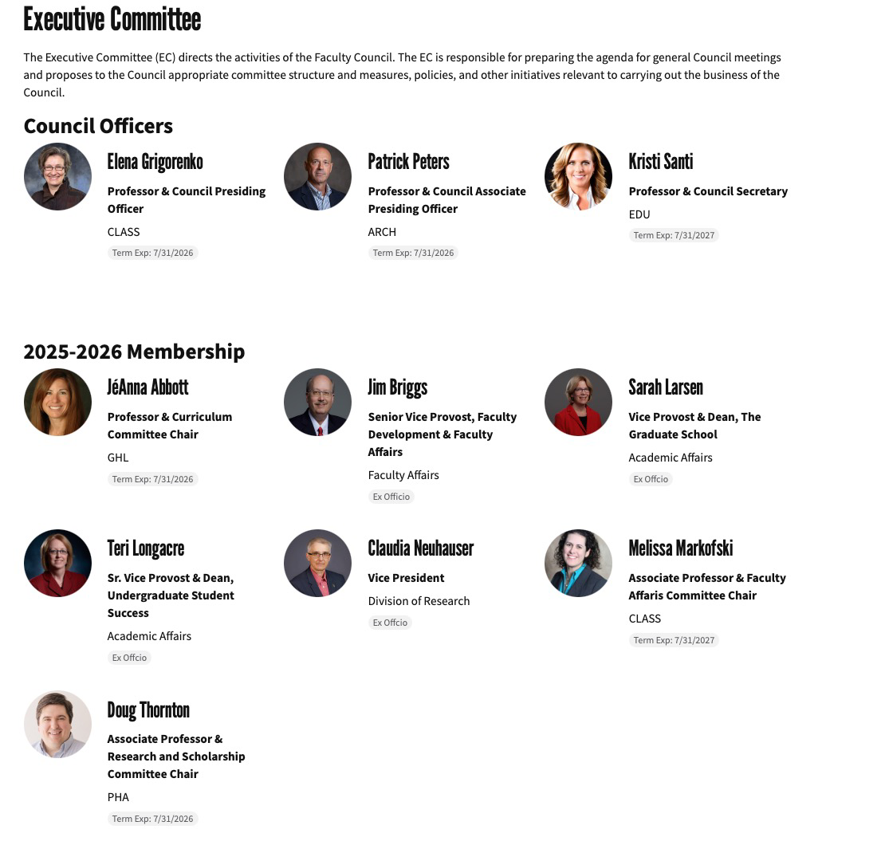

Slide 9
Immediate Structural Changes – restricted 140 senators to maximum of 60 doing the same work as before?
Combined undergraduate with graduate curriculum into one committee
Eliminated Budget & Facilities, Community and Government Relations Committees
Added Administrators into Executive Committee – representing 40 percent of the committee

Slide 10
Impact on experience and institutional memory
Bench is no longer as deep
Elected senators terms changed from 3 year to 2 year terms
Must wait one term before running again
Administrative appointed senators are on a year to year basis – but can serve up to 6 consecutive terms
Result: – reduced opportunity for developing governance skills & institutional knowledge

Slide 11
Less Autonomy
No election for the presiding officers
Officers are appointed annually by the President of the University
Results:
  Possible impact on the credibility of the officers for representing faculty.
  Undermines developing governance skills & institutional knowledge for senate leadership.

Slide 12
1. Hierarchical Command (The Worst)
Top-down control: Admin make all choices without faculty input.
No voice: Faculty only receive instructions and execute tasks.
Low trust: Results in low engagement, poor retention, and frustration. [1, 2, 3]
2. Token Consultation
One-way sharing: Admin informs groups after a choice is already made.
Illusion of input: Feedback is collected via surveys, but admin ignore or cherry-pick results.
No authority: Participants lack ownership over the final outcome. [1, 2]

Slide 13
3. Participatory Feedback (Participatory Management)
Active asking: Admin brings problems to faculty and asks for ideas.
Leader decides: Faculty test ideas or offer suggestions, but admin retain final veto power.
Partial value: Improves communication, but fails to grant true operational control. [1, 2]
4. Collaborative Co-Design
Shared tables: Joint involvement of faculty and admin to define problems and shape policies together.
Equitable weight: No single role completely dominates the decision process.
Clear accountability: Decisions align with the organization's goals, and teams help build the action plan. [1, 2, 3, 4, 5]

Slide 14
5. Autonomous Self-Governance (The Best)
Point-of-service authority: Faculty make independent choices regarding their direct work and standards (i.e., curriculum and research).
Facilitative leadership: Admin act as resource providers and boundary setters rather than micromanagers.
Full ownership: Complete partnership, equity, and accountability rest directly with those who execute the work

Slide 15
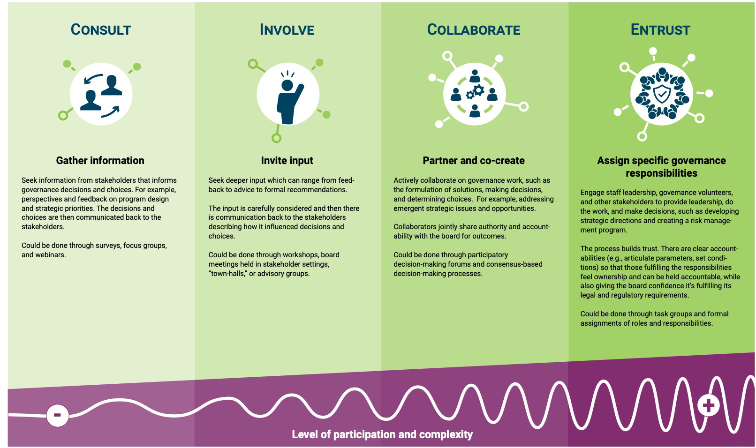
https://nonprofitresources.ca/wp-content/uploads/2022/11/Continuum-of-participation-in-a-nonprofits-governance-resource_final.pdf

Slide 16
Compact 2.0 Involvement
“For several months, I have participated in broader discussions with the White House and other higher-education leaders about issues affecting the sector. I expect those conversations helped inform the administration’s thinking around their Monday letter. I was not involved, however, in the drafting of the letter.”
Andrew D. Martin, chancellor of Washington University in St. Louis
https://www.chronicle.com/article/college-leaders-play-down-their-involvement-in-compact-2-0

Slide 17
Barbara R. Snyder, president of the AAU
Described a complicated feedback process with the Trump administration in which AAU representatives had little control over drafts.
She, Girod, and Ronald J. Daniels, president of the Johns Hopkins University, met with officials from the Education Department and the White House two or three times in person and a couple of times over the phone, she said. Girod and Daniels were acting in their capacity as chair and vice chair of AAU’s board. They always met with Trump officials as a group of three, Snyder said.
They provided feedback on drafts, which they did not receive copies of. They were allowed to see them only during the meetings.
Without access to past drafts, Snyder said she couldn’t exactly recall what changed over the course of their meetings, but she said: “The first draft we saw was already quite different from the compact, and the final draft is quite different from the first draft. Did they listen to some of our suggestions? Yes. Did they take all of our suggestions? No.”

Slide 18
RACI framework – who are
Responsible (does the work),
Accountable (has the final yes/no),
Consulted (provides input), and
Informed (kept in the loop)
Traditional definition of Decision rights define who has the formal authority to make specific organizational choices.
Decision rights (shared governance) defined as right to optimally be involved/participate to help achieve the best decision

Slide 19
Shared Governance Success Metrics
Do faculty value the role of Faculty Council as voice of faculty?
  Measures: Satisfaction Survey, Actual Desire to Participate as Senators
Mutual Respect and Belief in the value of one another
  Among faculty
  Between Faculty and Administration
Trust
  Reliability = Each party will consistently provide positive contribution, is dependable and honest
  Vulnerability = Willing to take the risk that each party will not “harm” the other in order for their own opportunistic benefit
  Share same beliefs and moral values (i.e., shared governance, shared goals)
  Caring for the welfare of each other (i.e., helping the performance of each party)

Slide 20
Are there both Formal and Informal Networks of communication?
Formal Structures – part of Standard Operating Procedures (SOP)
  Focuses on Task oriented interaction (e.g., committees in Bylaws)
Informal Structures
  Opportunity to be Person oriented
  Build relationships of Trust
Informal Relationships are critical when SOP is not enough
Assessment since SB 37: The informal networks have decreased

Slide 21
FACULTY GOVERNANCE REVIEW
Faculty Council
Bylaws Comparison
FORMAL VOTE
Faculty retains control
PROCEDURAL POWER
Administration gains influence
How the updated bylaws redistribute authority
between faculty and administrators
Produced by ChatGPT
NET EFFECT
Less independent faculty governance
Original and updated documents | September 2026
Notes:
Source: Original.pdf and Update.pdf supplied by the user. Analysis compares the text of the two bylaws documents.

Slide 22
EXECUTIVE CONCLUSION
Overall governance shift – Faculty Council Bylaws Update By BOR August 2026
The update changes the Council from a largely faculty-directed advisory body into a jointly managed structure.
WHAT FACULTY RETAINS
WHAT ADMINISTRATION GAINS
Formal voting control
Agenda approval
Council officer positions
Committee priority setting
Representation on key bodies
Leadership and staff influence
Governance power moves upstream, before the vote occurs.
Produced by ChatGPT
Faculty Council Bylaws Comparison
2
Notes:
Source: Original.pdf and Update.pdf supplied by the user. Analysis compares the text of the two bylaws documents.

Slide 23
PROCEDURAL POWER MAP
Where authority shifts
GOVERNANCE MECHANISM
ORIGINAL
UPDATED
EFFECT
Council agenda
Consultation
Provost approval required
Strong shift
Executive Committee
Faculty chaired
Faculty and administrator co-chaired
Strong shift
Committee chairs
Elected by committee
Jointly appointed
Strong shift
Standing committees
Faculty advisory agenda
Annual administrative charge
Moderate to strong
Faculty Council Bylaws Comparison
Produced by ChatGPT
3
Notes:
Source: Original.pdf and Update.pdf supplied by the user. Analysis compares the text of the two bylaws documents.

Slide 24
MEMBERSHIP CHANGES
Representation and continuity
ELECTED COUNCILORS
APPOINTED COUNCILORS
2 years
No consecutive elected terms
Up to 6 years
One-year terms with reappointment
Formal equality does not guarantee equal practical influence
CONTINUITY
Appointed members can build longer institutional memory and stronger relationships.
TURNOVER
Elected representatives must rotate off after one term.
ADMINISTRATIVE PRESENCE
Four senior administrators receive continuing, defined Council roles.
Faculty Council Bylaws Comparison
Produced by ChatGPT
4
Notes:
Source: Original.pdf and Update.pdf supplied by the user. Analysis compares the text of the two bylaws documents.

Slide 25
EXECUTIVE COMMITTEE AND COMMITTEE CHAIRS
Leadership becomes jointly managed
ORIGINAL STRUCTURE
UPDATED STRUCTURE
Faculty Presiding Officer leads the Executive Committee.
Senior Vice Provost co-chairs the Executive Committee.
Standing committees elect their own chairs.
Faculty officers and administrative representatives appoint chairs and associate chairs.
Administrators participate through consultation.
Administrators help develop agendas and build consensus.
Non-voting status limits formal authority, but not influence over deliberation and leadership selection.
Faculty Council Bylaws Comparison
Produced by ChatGPT
5
Notes:
Source: Original.pdf and Update.pdf supplied by the user. Analysis compares the text of the two bylaws documents.

Slide 26
COMMITTEE CHARGES AND SCOPE
Standing committees receive administrative direction
Faculty Engagement
Curriculum
Research and Scholarship
Annual charge from the Senior Vice Provost.
Agendas and activities developed with the Provost or delegate.
Employment conditions and workload are no longer expressly assigned.
Annual charge from two vice provosts.
Agendas and activities developed with the Provost or delegate.
Faculty retain an advisory role on curriculum and standards.
Annual charge from the Vice President for Research.
Agendas and activities developed with the VPR or delegate.
Selection language changes from election to appointment.
Coordination improves, while independent faculty agenda setting declines.
Faculty Council Bylaws Comparison
Produced by ChatGPT
6
Notes:
Source: Original.pdf and Update.pdf supplied by the user. Analysis compares the text of the two bylaws documents.

Slide 27
EXECUTIVE AND SYSTEM REPRESENTATION
Faculty access and external voice narrow
CHANNEL
UPDATED LANGUAGE
LIKELY EFFECT
President’s Cabinet
Guaranteed faculty seat removed
Direct faculty access to executive deliberations declines
Board of Regents
Regular reporting becomes “as needed”
Faculty reporting becomes less certain
UFEC
Provost and Senior Vice Provost added
Representation changes from faculty to mixed
Texas faculty senates
Membership language becomes conditional
Continuing external participation is less assured
UCC policy review
Limited to proposals in the formal process
Informal or early faculty review may narrow
Faculty Council Bylaws Comparison
Produced by ChatGPT
7
Notes:
Source: Original.pdf and Update.pdf supplied by the user. Analysis compares the text of the two bylaws documents.

Slide 28
BALANCED ASSESSMENT
Benefits and governance risks
POTENTIAL BENEFITS
PRINCIPAL RISKS
01
Earlier identification of operational constraints
01
Administrative control before faculty votes
02
Better access to senior decision-makers
02
Reduced committee and agenda independence
03
Clearer terms, vacancies, and administrative roles
03
Leadership accountability shifts upward
04
Faster implementation of supported recommendations
04
Dissenting faculty views may receive less exposure
The update favors integration and implementation over institutional independence.
Produced by ChatGPT
Faculty Council Bylaws Comparison
8
Notes:
Source: Original.pdf and Update.pdf supplied by the user. Analysis compares the text of the two bylaws documents.

Slide 29
POSSIBLE REVISIONS
Safeguards for a more balanced model
AGENDA
Require consultation, not Provost approval.
COUNCIL STAFF
Give faculty officers functional direction.
EXECUTIVE COMMITTEE
Keep the faculty Presiding Officer as sole chair.
EXECUTIVE ACCESS
Restore the President’s Cabinet seat or an equivalent right.
COMMITTEE CHAIRS
Restore election by committee members.
COUNCIL TERMS
Reduce the continuity gap between elected and appointed members.
ANNUAL CHARGES
Protect space for faculty-initiated priorities.
FACULTY AFFAIRS
Restore explicit jurisdiction over workload and employment conditions.
Balanced shared governance requires faculty authority over both votes and the procedures that lead to them.
Faculty Council Bylaws Comparison
Produced by ChatGPT
9
Notes:
Source: Original.pdf and Update.pdf supplied by the user. Analysis compares the text of the two bylaws documents.

Slide 30
SB 37 and Faculty Council bylaw changes
Only a limited set of changes was legally required
REQUIRED BY SB 37
UH SYSTEM POLICY
NOT REQUIRED BY SB 37
Statute directs these provisions
Board-selected implementation
Institutional choices that expand control
01
Two-year elected terms
01
Exclude administrators above chair level
01
Provost approval of the Council agenda
02
One-year appointed terms
02
Administrator co-chair of Executive Committee
02
Administrators assist the Council
03
Six-term appointed limit
03
Joint appointment of committee chairs
04
Seven-day agenda posting
03
Equitable faculty-category representation
Annual administrative committee charges
04
05
Curriculum proposal posting
75% in-person attendance rule
05
Administrative control of Council staff
Quorum rules
04
06
Removal of guaranteed President’s Cabinet seat
06
07
Advisory-only status
Bottom line
Most new administrative process controls go beyond the statute.
Sources: Texas SB 37, Education Code §§ 51.3522–51.3523, UH System Board Policy 21.13, Original.pdf, and Update.pdf
Produced by ChatGPT
Policy analysis, not legal advice
Notes:
Sources: Enrolled Texas Senate Bill 37 (89th Legislature); Texas Education Code sections 51.3522 and 51.3523; University of Houston System Board Policy 21.13; Original.pdf; Update.pdf. Main conclusion: membership terms, public-notice requirements, advisory status and quorum rules were required; agenda approval, administrative co-chairing, committee-chair appointments, annual charges, staff oversight and removal of Cabinet access were not required by SB 37.

Slide 31
My Assessement: Impact of Structural Changes from SB 37
Less Experienced Senators including lack of understanding of shared governance and institutional history
  e.g., never heard of the Red book.
Disrupt Leadership Selection and Development (who is better positioned to select Council Leaders – senators or admin?)
Voice of the Faculty? Representation and Facilitation of Faculty Expertise
In the past, Faculty proactively raise awareness of issues to administration in addition to hearing concerns from admin. Unclear how well rank and file faculty concerns will be heard.

Slide 32
Additional observations
Beware of conflating frequency of admin/faculty interactions with shared governance
Have new policies been introduced without optimal involvement?
Pre SB 37
  No new policies or decision implemented in the summer (Faculty Senate Resolution passed on this issue and acknowledged by admin)
  Senate Bylaws changes require two readings beyond good process for a vote.
  Admin made effort to provide advance warning of official announcements.
  Greater bottom up information alerts (providing critical alerts to new issues that impact the University in terms of teaching and research from faculty).
Post SB 37
  Emboldens those administrators who either have micro managing or autocratic personality traits
    e.g., Bylaw changes this past August
  Highlights those administrators who never shared the underlying precept of the value of faculty expertise in institutional decision making

Slide 33
Vouchers MAPP 04.01.03 revised without participation of faculty (note: Budget and Facilities Committee no longer exists) (last slide)
October 23, 1992; previous revision October 1, 2024, revised on September 21, 2026
The following approvals are required for all other reimbursements besides business meals:
Any amount
• Supervisor & Department Business Administrator
Over $500
• include Department Business Administrator
Over $1,000
• include Dean, AVP, Equivalent (i.e., the person that reports directly to the area VP)
▪ Over $2,000
Include Vice President/Vice Chancellor

Slide 34
S
SB37 Effects on Shared Governance at UH: A Pre & Post Assessment
Texas Council of Faculty Senates, Fall Meeting
September 25, 2026 Austin, TX
Dr. Wynne W. Chin*
C. T. Bauer Professor of Decision Science - University of Houston
* The views and material expressed in this presentation are solely my own as an individual and do not necessarily reflect the official positions, policies, or opinions of the University of Houston. Any factual errors are non-intentional.

Slide 35
Herbert Simon’s Decision Activity Framework
Intelligence: Find the problem or need. Collect facts and data.
Design: Make a list of possible solutions. Think about how each option works.
Choice: Pick the best option from your list.
Implementation: Put your choice into action. Check the results later

Slide 36
The term "wicked problems" was brought into management and planning literature by C. West Churchman, who used it in a 1967 editorial for Management Science to describe social system problems that are ill-formulated and resistant to resolution. [1, 2, 3]
Origin and Meaning
The 1967 Seminar: Churchman reported on a presentation by design theorist Horst Rittel at a University of California, Berkeley seminar. [1, 2]
Definition: Churchman described them as problems with confusing information, conflicting values among decision-makers, and systemic ramifications that defy clear solutions. [1]
Moral Duty: Churchman emphasized that scientists and planners have a moral responsibility to engage with these messy, real-world dilemmas rather than hide behind purely technical or idealized models. [1]
Key Traits
Ill-defined: They lack a definitive formulation or clear boundaries.
No Stopping Rule: There is no objective test or clear point when a wicked problem is "solved".
Value Conflicts: Solutions are judged as good or bad based on differing human values, not true or false facts

