Slide 1

TCFS Orientation
Fall 2026
Tabitha S. Morton, President
September 25–26, 2026
Austin, Texas
txfacultysenates.org
01
Notes:
Welcome new and returning attendees. TCFS brings faculty governance representatives together across Texas. This orientation introduces the organization, its recent work, and the Fall meeting.

Slide 2
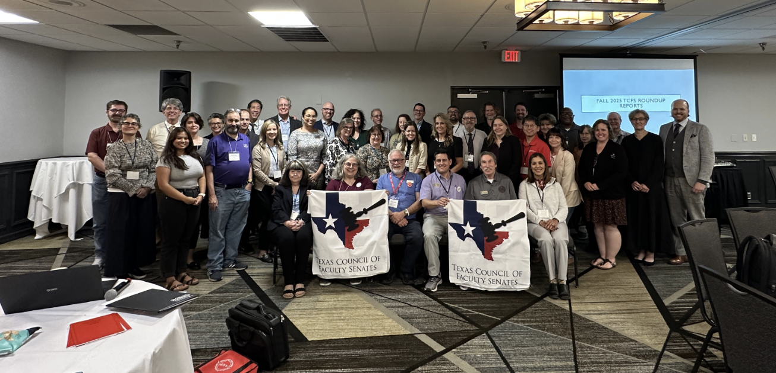
Who We Are
A statewide federation of faculty
senates, councils, and assemblies
TCFS connects faculty governance bodies
at Texas public senior colleges and universities.
An informal network began in 1978.
TCFS organized independently in 1983.
Institutional membership
Dues-paying members have voting privileges.
About TCFS
02
Notes:
TCFS supports communication across institutions, assists campus governance bodies, and represents their concerns to other bodies. Meetings offer a place to compare campus experiences.
Membership belongs to faculty governance organizations. Do not treat individual registration as institutional dues.

Slide 3
Our Purpose
TCFS meets twice a year to share governance experience statewide, timed with the AAUP annual meeting.
1
Coordination
Maintaining communication and coordination among faculty governance organizations statewide.
2
Support
Assisting faculty governance organizations in carrying out their responsibilities.
3
Representation
Representing faculty governance organizations’ professional standards and academic responsibility to government and other bodies.
Founding purpose · About
03

Slide 4
What TCFS does
1
Leadership workshops
Conducts workshops for faculty leaders on college and university governance topics.
2
Member web resources
Maintains a website with links to member campus governance pages.
3
Information sharing
Responds to requests for information on faculty governance topics.
4
Statewide representation
Represents member organizations’ views statewide when approved by TCFS.
Ongoing programs · About
04

Slide 5
Our Website
1
About
Purpose, member institutions, and the constitution and bylaws
2
Organization
Leadership contacts and regional alignment
3
Meetings
Meeting dates and the role of Roundup Reports
4
Proceedings and Fees
Meeting records, registration details, and dues information
txfacultysenates.org
05
Notes:
Use About for the governing documents and Organization to find your regional vice president. Proceedings is the website’s meeting-records section. Use Fees for current payment instructions.
Sources: https://www.txfacultysenates.org/about/; https://www.txfacultysenates.org/organization/; https://www.txfacultysenates.org/meetings/; https://www.txfacultysenates.org/fees/. Website navigation links to https://www.txfacultysenates.org/proceedings/. Accessed September 13, 2026. The Spring minutes used in this orientation are the supplied PDF.

Slide 6
Executive Leadership
President
Tabitha S. Morton
Prairie View A&M University
President-Elect
Christopher A. Gabler
University of Texas Rio Grande Valley
Treasurer
Wynne Chin
University of Houston
President Emeritus
Jim Woosley
Texas A&M University – College Station
Executive Secretary
Deborah Roberts
TCFS_meeting@yahoo.com
Current names and roles: Organization
06
Notes:
Introduce the officers and Executive Secretary. The Organization page is the current directory for contact information.
Source: https://www.txfacultysenates.org/organization/ (accessed September 13, 2026). Use website titles as shown, including Treasurer and President Emeritus.

Slide 7
Your Regional Vice Presidents
East Region
Northeast Region
Zachary Valdes
Lamar University
Melissa M. McKay
University of North Texas
South Central Region
West Region
Scott Johnson
Texas A&M University–Corpus Christi
Jessica Velasco
Sul Ross State University
Your regional VP is a contact for campus concerns and TCFS participation.
Find your institution’s region: Organization
07
Notes:
Regional vice presidents help plan meetings and coordinate work between meetings. Invite attendees to identify their region and introduce themselves to their VP.
Sources: https://www.txfacultysenates.org/organization/ (accessed September 13, 2026), names, roles and affiliations. Spring-2026-TCFS-Meeting-Minutes-Final-2.pdf, p. 3, regional VP responsibilities.

Slide 8
TCFS in Practice: Spring 2026
58
21
34
total attendees
universities represented
TCFS members present
February 27–28, 2026
San Antonio
The business meeting addressed the budget, reviewed prior minutes, considered governance proposals, and elected leaders.
Spring 2026 meeting minutes, pages 1–4
08
Notes:
The minutes distinguish 34 TCFS members from 24 representatives of AAUP, TACT, TAFT, TFA, and NAACP, for 58 total attendees. Twenty-one universities had representation. These are Spring 2026 attendance figures, not total TCFS membership.
Source: Spring-2026-TCFS-Meeting-Minutes-Final-2.pdf, pp. 1–4. The meeting occurred at Embassy Suites – San Antonio Brooks Hotel & Spa. The spring location is historical; the Fall 2026 meeting is in Austin.

Slide 9
What Members Discussed and Decided
1
Financial sustainability
Reviewed a funding shortfall and possible cost reductions.
2
President Emeritus bylaws proposal
Approved submission to the membership by email ballot.
3
Shared-governance white paper
Returned the draft to committee for further work.
4
Leadership elections
Elected a President-Elect and three regional VPs.
Spring 2026 meeting minutes, pages 2–4
09
Notes:
Financial sustainability: Wynne Chin reported reduced system contributions and recommended options including canceling a meeting or holding one of every four meetings virtually. The minutes do not record adoption of either option. Morton invited members to help with requests for system support.
Bylaws: Members approved sending the President Emeritus proposal to the full membership by email ballot. This describes the February action, not the later ballot outcome.
White paper: Members discussed a concise statement about governing boards, administration, and faculty. The motion was withdrawn so the draft could return to committee for further work and sensitivity edits. Do not describe the paper as adopted policy.
Elections: Melissa M. McKay, Jessica Velasco, Christopher A. Gabler, and Scott Johnson won election by acclamation.
Source: Spring-2026-TCFS-Meeting-Minutes-Final-2.pdf, pp. 2–4.

Slide 10
Friday in Austin
September 25
All times p.m. except the 11 a.m. start
11:00–12:30
Lunch on your own and systems meetings
12:30–12:40
Welcome and agenda overview
12:40–1:40
Shared Governance Then and Now
1:50–5:45
Roundup Forum, roundtables, and non-member reports
5:45–7:00
Networking
7:30–9:00
Banquet dinner with Dr. Bill Kibler
Embassy Suites by Hilton Austin Central
5901 N IH-35, Austin, TX 78723
Provisional schedule: supplied Fall agenda 2.0
10
Notes:
General attendees meet Friday–Saturday, September 25–26. The Executive Board meets Thursday, September 24, 7–9 p.m. Friday’s panel lists Wynne Chin and David Rembert. All Friday times are afternoon/evening except the 11 a.m. lunch start. The 1:50–5:45 block includes breaks. The supplied agenda labels itself a template, so the listed schedule and speakers remain subject to confirmation.
Source: TCFS_Fall_2026_Meeting_Agenda_2.0.docx, Thursday and Friday sections. Location and general meeting dates also appear at https://www.txfacultysenates.org/meetings/ (accessed September 13, 2026).

Slide 11
Roundup Reports Give Each Campus a Voice
Friday’s Roundup Forum
A useful contribution
1:50–2:50
Part I: Reports
A campus development worth sharing
A governance concern with a concrete example
A question or practice that other institutions can use
3:00–4:20
Part II: Roundtables
4:30–4:45
Non-member Round Reports
4:45–5:45
Part III: Roundtables
All times p.m. / Provisional agenda 2.0
Roundup purpose: Meetings
11
Notes:
The website describes Roundup Reports as campus news that can inform meeting discussion and changes at home institutions. The prompts on this slide are suggested preparation, not an official required reporting format. Coordinate with your campus delegation and follow the facilitator’s time limit. Identify both successes and concerns. Listen for common issues that warrant continued discussion.
Sources: https://www.txfacultysenates.org/meetings/ (accessed September 13, 2026); TCFS_Fall_2026_Meeting_Agenda_2.0.docx, Friday Roundup Forum. All times shown are p.m.

Slide 12
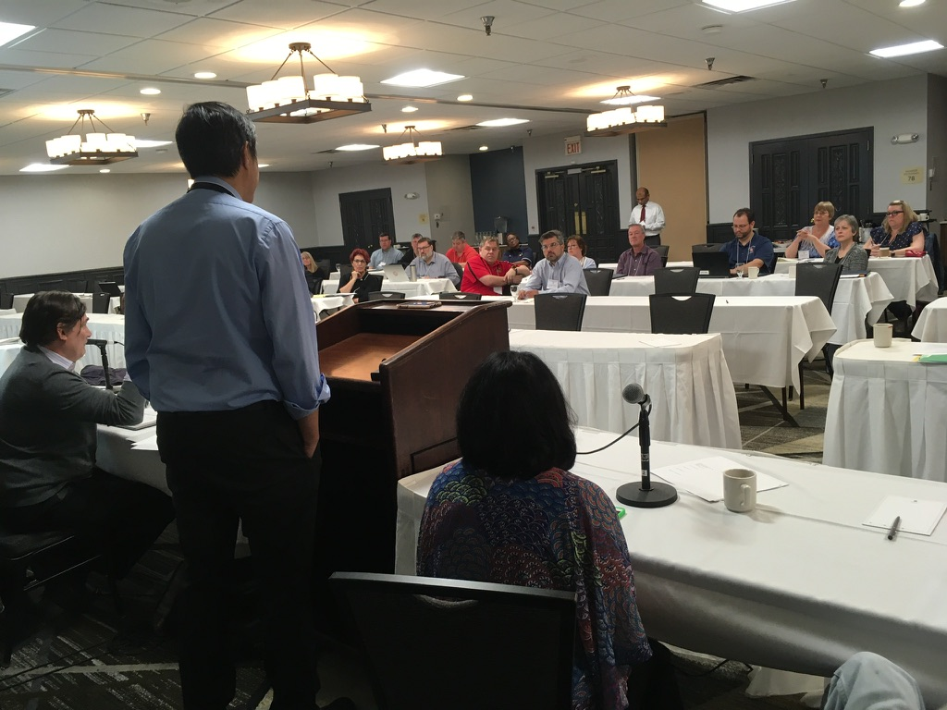
Saturday’s Business Meeting
September 26
8:30–10:00 a.m.
Approve Spring 2026 minutes
Treasurer’s report
Vice President regional reports
New business and adjournment
Provisional schedule: supplied Fall agenda 2.0
12
Notes:
Read the Spring 2026 minutes before Saturday. Listen for corrections to the record, financial updates, and issues brought forward through the regions. Membership and voting eligibility follow TCFS rules; confirm your institution’s status with the Executive Secretary if needed.
Sources: TCFS_Fall_2026_Meeting_Agenda_2.0.docx, Saturday section; https://www.txfacultysenates.org/about/ for voting privileges. Photograph: TCFS Welcome Spring 2025_JV.pptx, slide 8. Photo illustrates a past meeting, not Fall 2026.

Slide 13
Your First Meeting
Before the sessions
During the meeting
Review the agenda and Spring minutes. Coordinate your campus report.
Introduce yourself to your regional VP. Ask specific questions and compare experiences.
Between sessions
After the meeting
Use networking time to find colleagues working on similar campus concerns.
Report back to your campus and follow up on contacts or shared work.
Leadership contacts: Organization
13
Notes:
These are suggested participation practices for first-time attendees. Encourage attendees to share future session ideas with the leadership and offer feedback when requested. A useful report back can distinguish what members discussed from what TCFS formally decided. The Fall agenda includes networking and Roundup discussions.
Sources: TCFS Welcome Spring 2025_JV.pptx, slides 21–25, structural reference; TCFS_Fall_2026_Meeting_Agenda_2.0.docx.

Slide 14
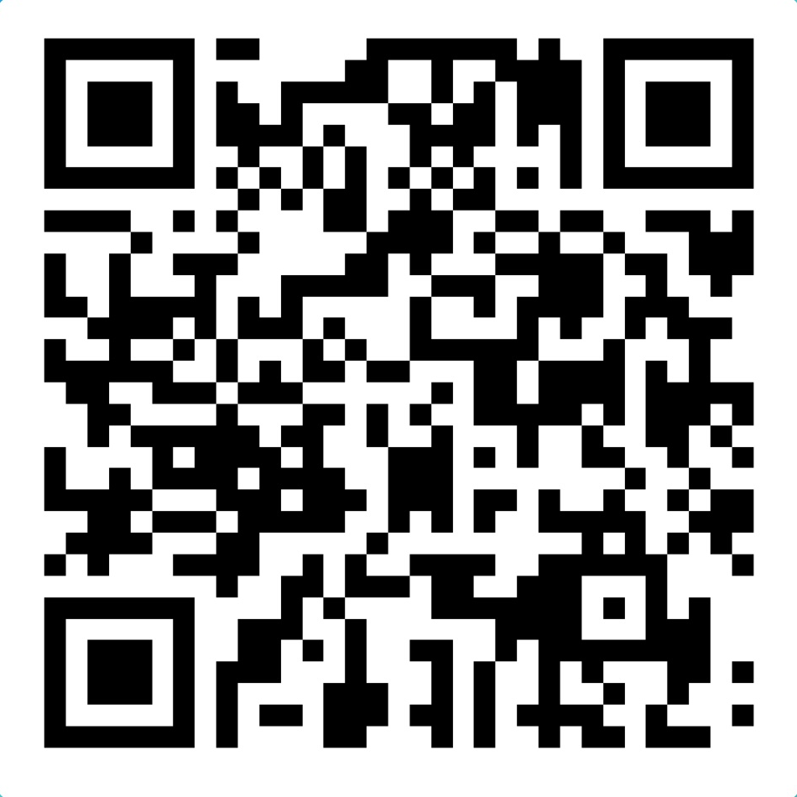
Resources and Questions
Meeting materials
Fall 2026 agenda
Spring 2026 meeting minutes
TCFS Orientation Feedback
Executive office
Scan to share your feedback
TCFS_meeting@yahoo.com
14
Notes:
Questions are welcome. Open the linked website sections for current information. Proceedings: https://www.txfacultysenates.org/proceedings/. Meeting-material sources supplied for this orientation: TCFS_Fall_2026_Meeting_Agenda_2.0.docx and Spring-2026-TCFS-Meeting-Minutes-Final-2.pdf. The Fall agenda identifies itself as a template; use the latest circulated program if it changes.
Website source: https://www.txfacultysenates.org/organization/ for the executive-office contact (accessed September 13, 2026). Logo: TCFS Welcome Spring 2025_JV.pptx, slide 1. Structural reference: that deck’s purpose, leadership, meeting activities, membership, Roundup Reports, and feedback sections.

